Slide 1




Malicious Domain Detection Using Machine Learning
Prepared by:
Puja Suresh Karnase
Dhanashri H. Jadhav
Bari Nikhil Nilesh
Pooja Bhaskarrao Kaware
Rutuja Patangrao Pawar
Guided by:
Ms. Swati Singh

Slide 2



Table of Contents
1
Introduction
2
Problem statement
3
Purpose of the project
4
Implementation
5
Methodology

Slide 3
Table of Contents
6
Dataset
7
Feature Extraction
7
8
Machine Learning Models
8
9
Model Deployment
9
10
Conclusions

Slide 4
01
Introduction

Slide 5
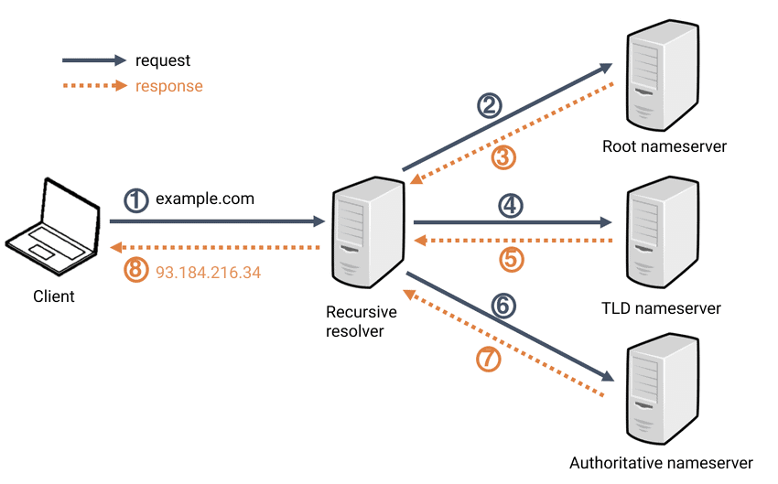
DNS Architecture

Slide 6


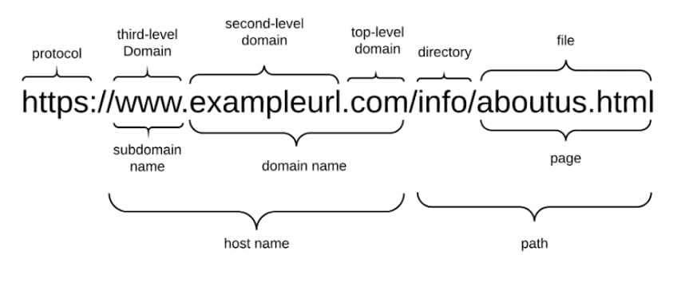


URL

Slide 7
02
Problem statement

Slide 8
Problem Statement
The challenge is to create a simple and efficient system capable of quickly identifying malicious domain on the internet.
The system needs to accurately spot patterns used by cybercriminals to deceive users, such as fake domain names or suspicious activities.
It should work fast, handle a lot of data, and adapt to new threats over time. This will help keep people safe online by preventing them from visiting harmful websites.

Slide 9
03
Purpose of the project

Slide 10
Purpose of the Project
To classify the domain as Benign or Malicious.
Due to the ease with which sensitive data on phishing attack patterns can be obtained, the problem of malicious domain detection makes it a prime candidate for the use of machine learning methods.
The main idea is to utilize machine learning techniques on a dataset of domains to develop a model that can be used to determine if a particular domain is a Malicious domain or a Benign domain in real-time.

Slide 11
04
Implementation

Slide 12
Implementation
The process of implementing the project:
Data Collection
Feature Extraction: Lexical Features and Whois Features.
Data Labelling
Divide the dataset into training and testing sets.
Algorithms used: Logistic Regression, Gradient Boosting.
Compare the obtained results for trained models and specify which is better.
Run the feature extraction code, call the TrainModel code that contains the trained model, and deploy the project using Flask.

Slide 13
05
Methodology

Slide 14
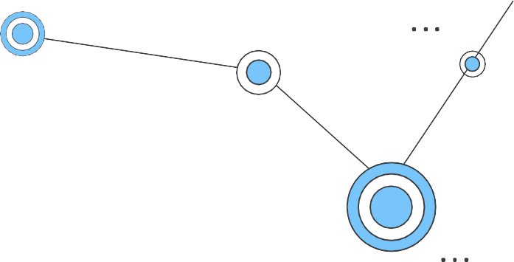
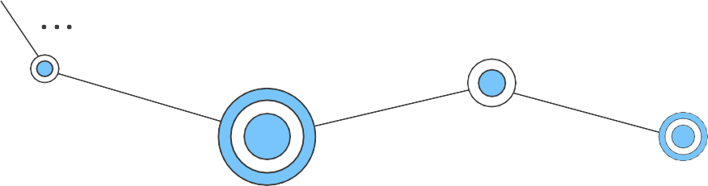
Methodology
01
Data Collection
02
Feature Selection
03
Data labelling
04
Machine Learning Models
05
Model Deployment

Slide 15
06
Dataset

Slide 16
Dataset
The final dataset contains of labelled data and domain data.
Each features is associated with a rule. If the rule is met, the Domain is Benign. If the rule does not meet, the Domain is Malicious.
The features have two distinct values:
Malicious
Benign

Slide 17
07
Feature Extraction

Slide 18
Feature Extraction
The following features were extracted:
IPwhois Features :
Registrar
Creation date
Expiration date
WHOIS Server
Name Server
Emails
dnssec
Address
IP_address

Slide 19
Feature Extraction
The following features were extracted:
Lexical Features :
Domain names
tld
tld_lengths
tld_types
dot_counts
hyphen_count
sld_consonant_ratio
sld_length
sld_numeric_length
vowel_length
Fada_count

Slide 20
08
Machine Learning Models

Slide 21
Machine Learning Models
This is a supervised machine learning task. There are two major types of
supervised machine learning problems, called classification and regression.
This data set comes under classification problem, as the input Domain is classified as Malicious or Benign.
The machine learning models used :
Gradient Boosting Classifier
Logistic Regression

Slide 22
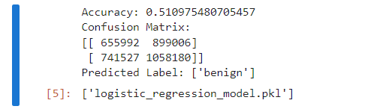
Machine Learning Models
Logistic Regression
Notes:
TP | FP
FN | TN

Slide 23
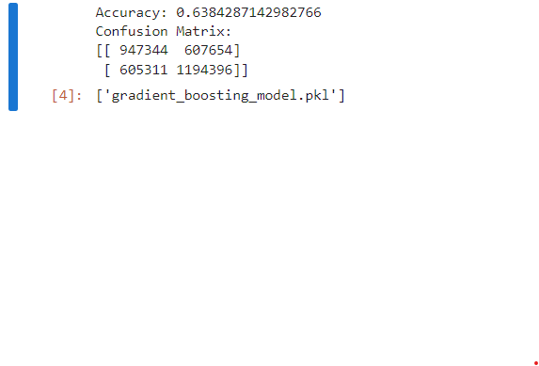
Model Comparison
Gradient Boosting

Slide 24
09
Model Deployment

Slide 25
Model Deployment
We have used Flask for model deployment.
Flask is a lightweight Python web framework for building web applications and APIs.
Steps for Deploying a Model with Flask:
- Prepare Your Model
- Install Flask
- Create Flask Application
- Load the Model
- Define Endpoints
- Handle Requests
- Return Predictions

Slide 26
Screenshots

Slide 27
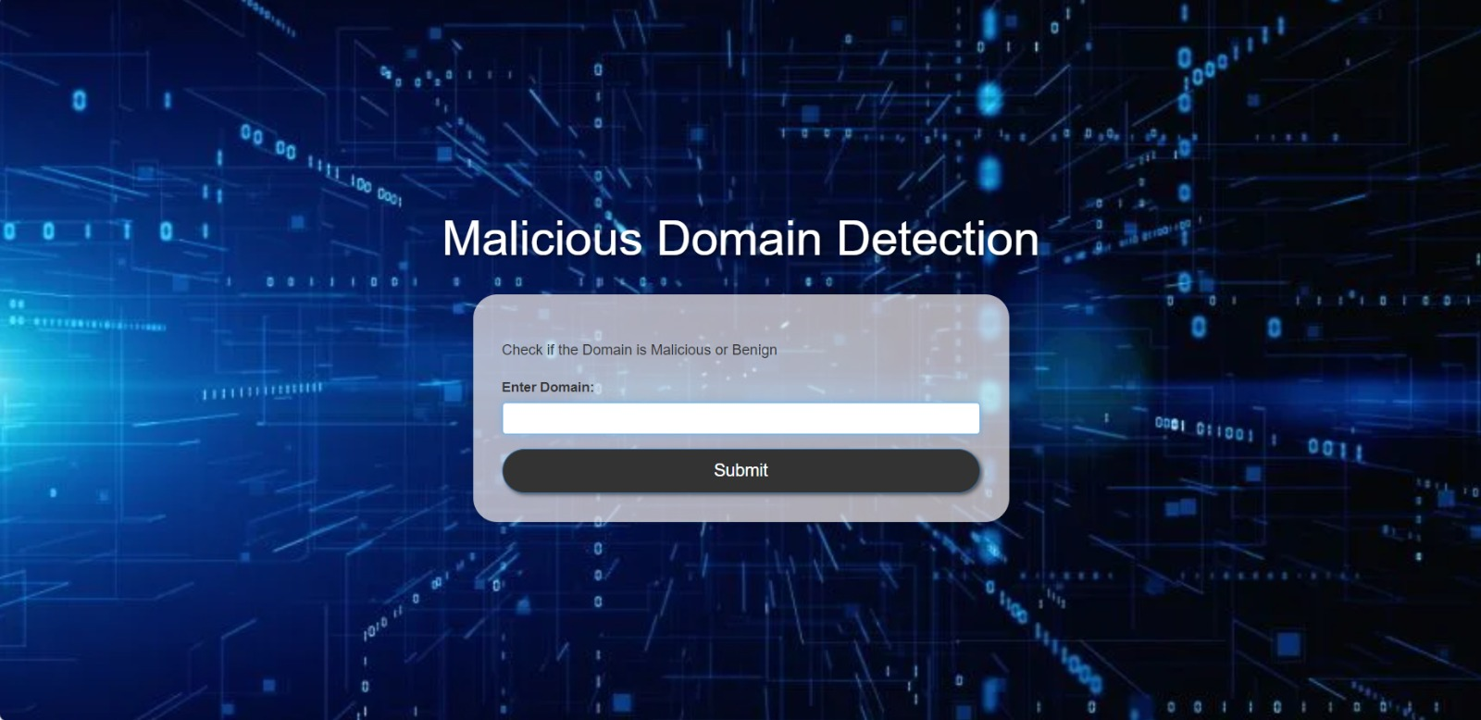
Screenshot: Enter Domain Name

Slide 28
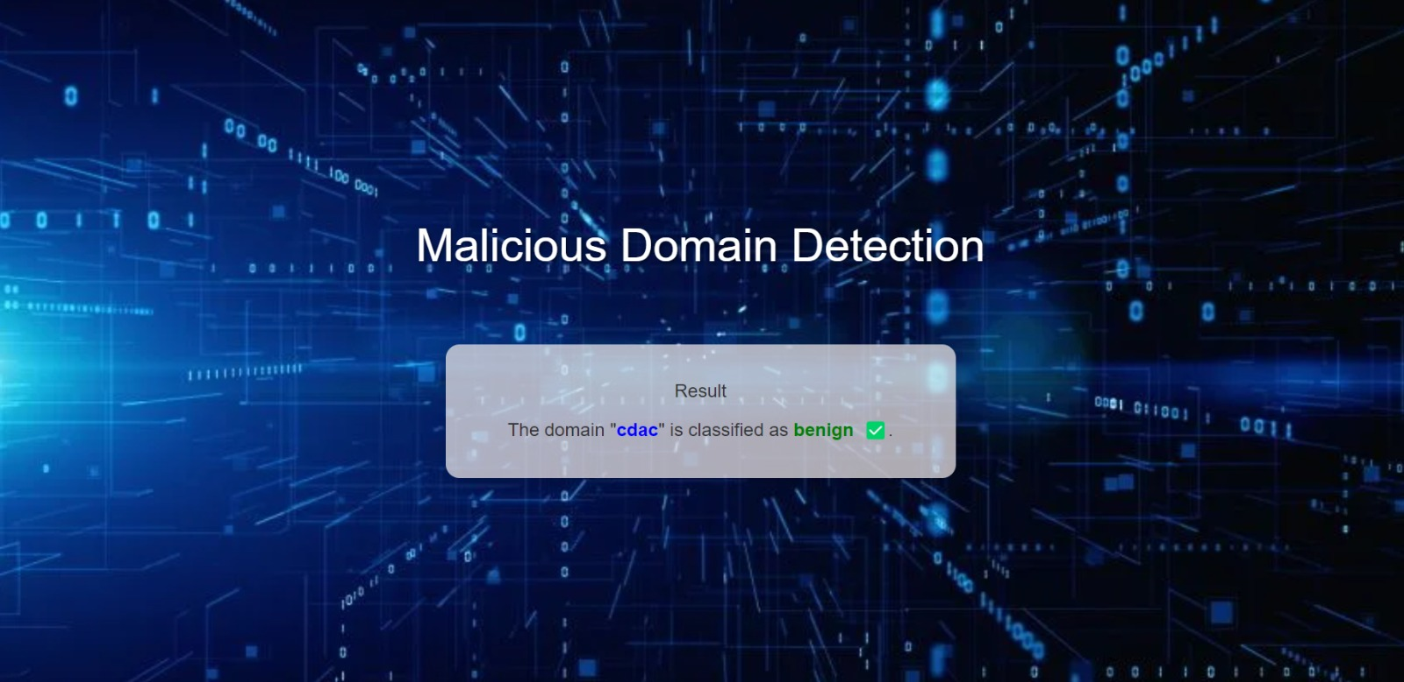
Screenshot: Domain classified as Benign

Slide 29
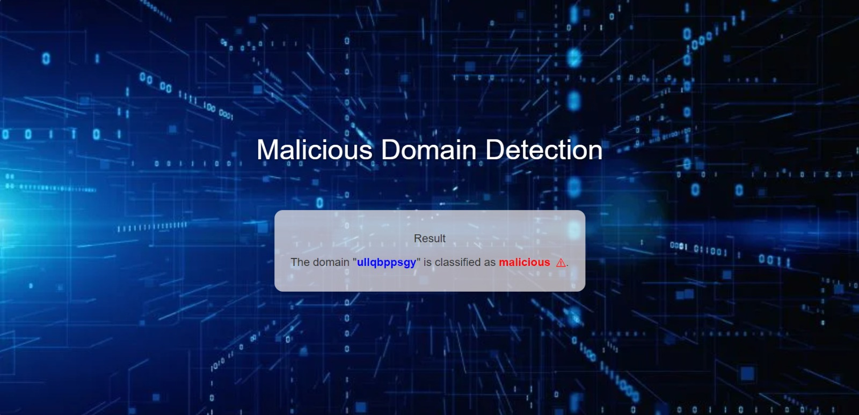
Screenshot: Domain classified as Malicious

Slide 30
10
Conclusions

Slide 31
Conclusion
The project aims to enhance its predictive capabilities, contributing to more effective cybersecurity measures and safeguarding users against malicious online activities.
We then chose the best algorithm based on its performance and designed a
flask tool for detecting Malicious Domains.
The tool allows end users to easily check if the Domain is Malicious or
Benign.
Our intent in the future is to make the tool integrated into systems or an
extension on web browsers.

Slide 32
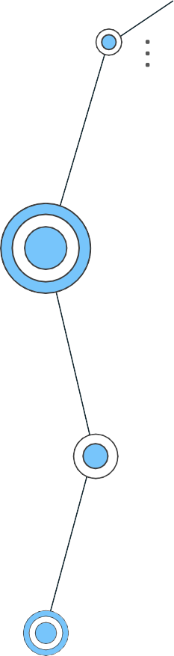
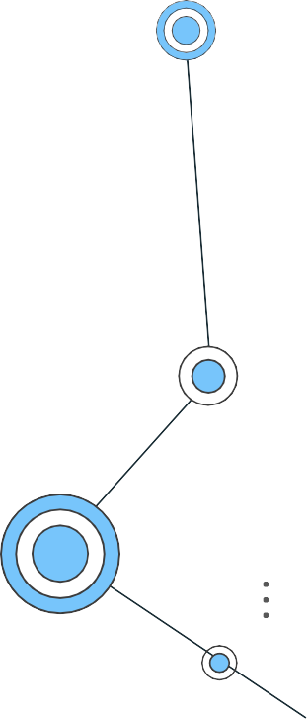
Thankyou!
Any questions?

